Slide 1
Multi-agent pathfinding in Kiva Systems
Phillip Wong
Daniel Harabor & Pierre Le Bodic
Notes:
Morning / Afternoon ~ Name - Phillip Wong ~ Proj: MAPF ~ Along with 2, Dan, Pierre

Slide 2
Multi-agent pathfinding
For all agents find a path to the goal
Ensure no conflicts
a1 |  |  | a2
g2 |  |  | g1
Notes:
Finding a path for all agent from their location to their goal

Slide 3
Multi-agent pathfinding
a1 |  |  | a2
g2 |  |  | g1

Slide 4
Multi-agent pathfinding
a1 |  | a2
g2 |  |  | g1

Slide 5
Multi-agent pathfinding
a1 | a2
g2 |  |  | g1

Slide 6
Multi-agent pathfinding
a1
g2 | a2 |  | g1

Slide 7
Multi-agent pathfinding
 | a1
a2 |  |  | g1

Slide 8
Multi-agent pathfinding
 |  | a1
a2 |  |  | g1

Slide 9
Multi-agent pathfinding
 |  |  | a1
a2 |  |  | g1

Slide 10
Multi-agent pathfinding
a2 |  |  | a1

Slide 11
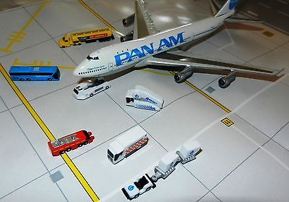
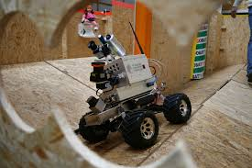
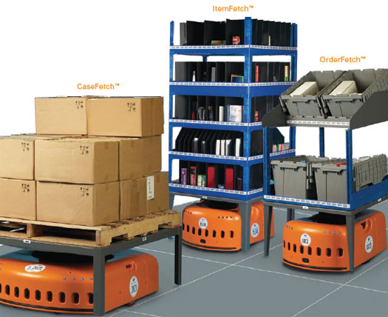
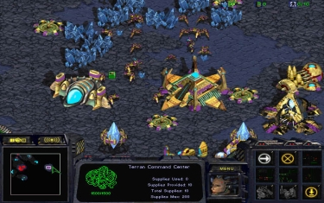
Motivation
Video games
Logistics
Robotics
Warehouse Automation

Slide 12
MAPF in Warehouse Automation
Warehouse Automation
Grid-based map (no diagonal movement)
Objective Functions
Makespan
Down-time
Sum of (distance) cost

Slide 13
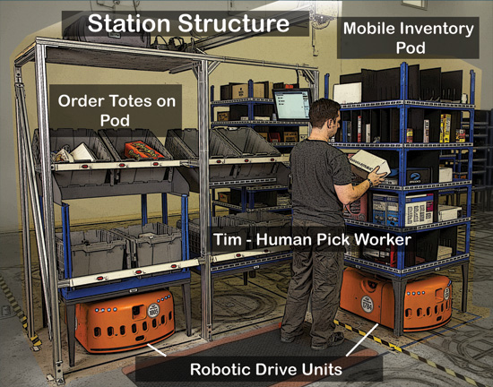
Warehouse Automation
Kiva Systems / Amazon Robotics
Large scale 1000+ robots
Put gif here
Notes:
Order a product from amazon, day arrival => kiva system will * process order * get the required inventory which is located around the warehouse * and packing it into a box

Slide 14
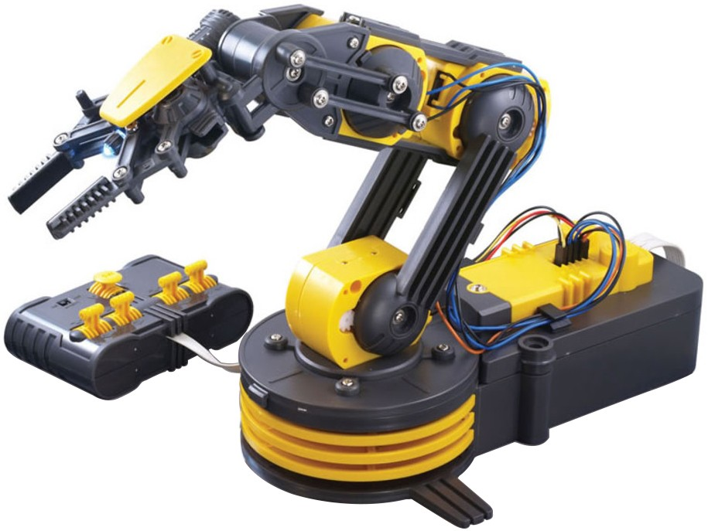


A complex system
Multiagent pathfinding
Replenishment
Robot allocation
Automated Picking
Warehouse Layout
Notes:
Scheduling problem
* Replenishment of parts and battery
* deciding which picking station is free
* drive allocation
Robotics – automated picking
Optimization
* Warehouse layout
MAPF

Slide 15
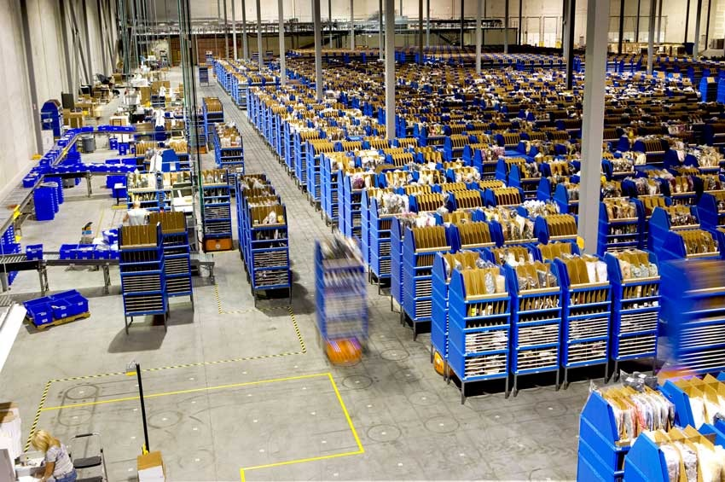
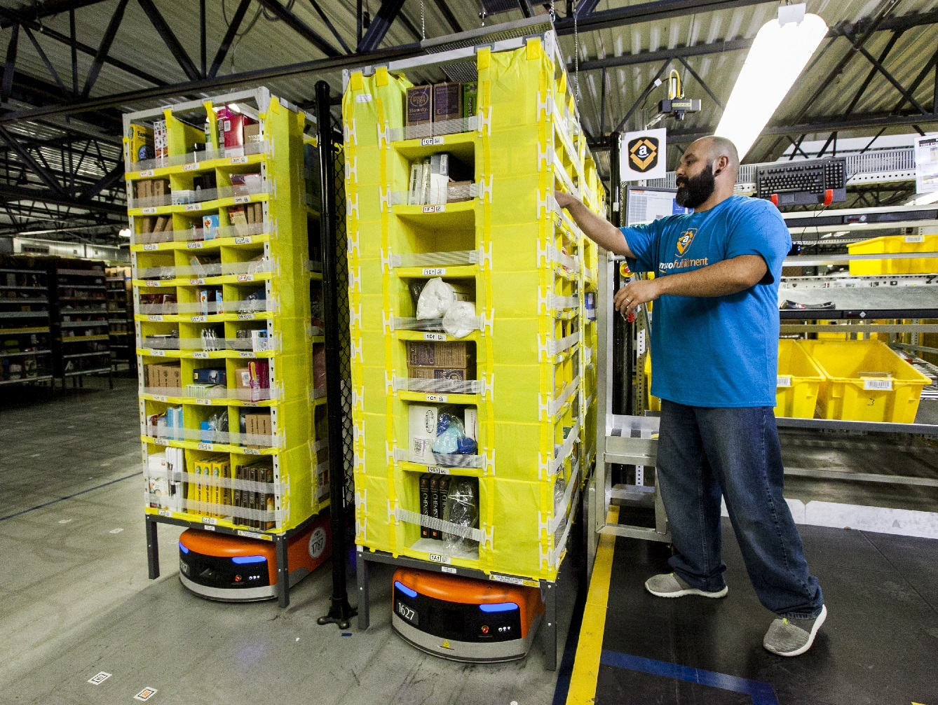
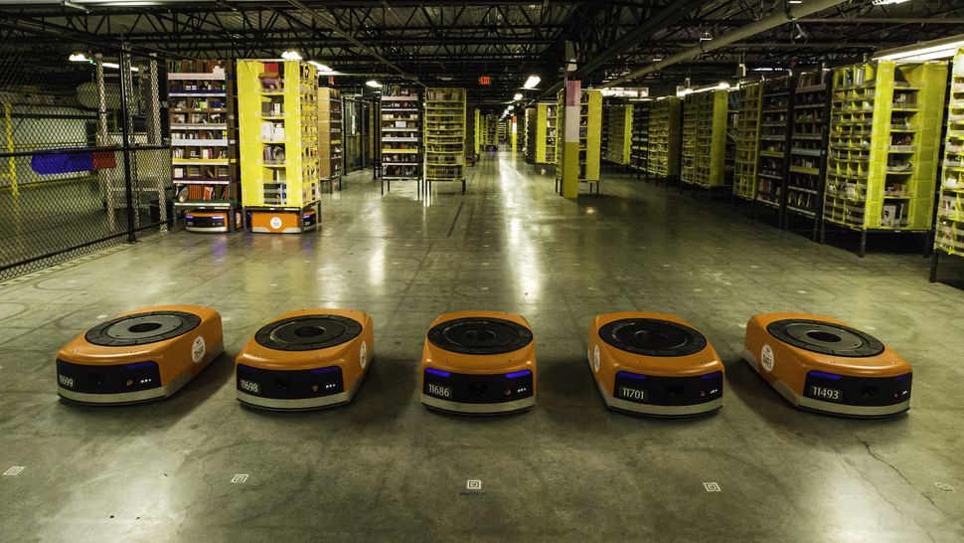
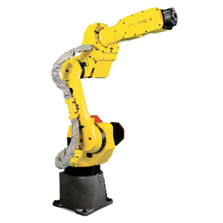
Part-to-picker system
Assign job
Bring ‘part’
Pick and pack

Slide 16
MAPF & part-to-picker system
Assign job
Bring ‘part’
Pick and pack

Slide 17
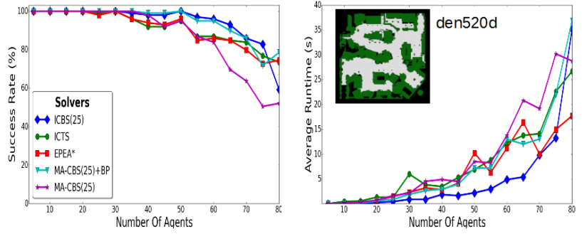
MAPF State of the art
Optimal state of the art
Conflict Based Search (CBS)
~80 robots, 13214 nodes
Non-optimal state of the art
2000+ agents, 15899 nodes (FAR)
TODO: GIF OF WURMAN’S WAREHOUSE SIM
Notes:
Makespan is really bad!

Slide 18

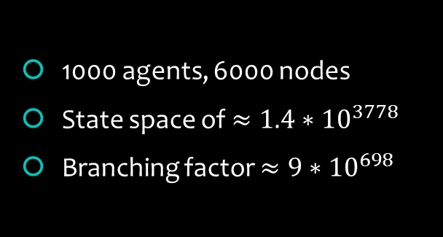
NP-Hard
1000 agents, 6000 nodes
State space of $≈1.4∗{10}^{3778}$
Branching factor ${≈9∗10}^{698}$
$k$ agents, $n$ nodes
$n^{k}$ state space
$5^{k}$ branching factor
15 | 2 | 1 | 12
8 | 5 | 6 | 11
4 | 9 | 10 | 7
3 | 14 | 13
1 | 2 | 3 | 4
5 | 6 | 7 | 8
9 | 10 | 11 | 12
13 | 14 | 15
Notes:
State space: ways to place agents on the grid
5 actions {up down left right wait}

Slide 19
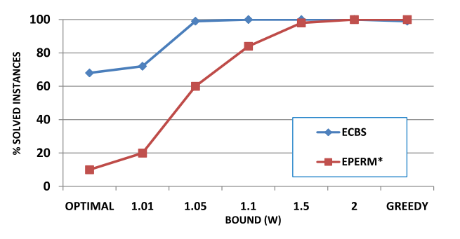
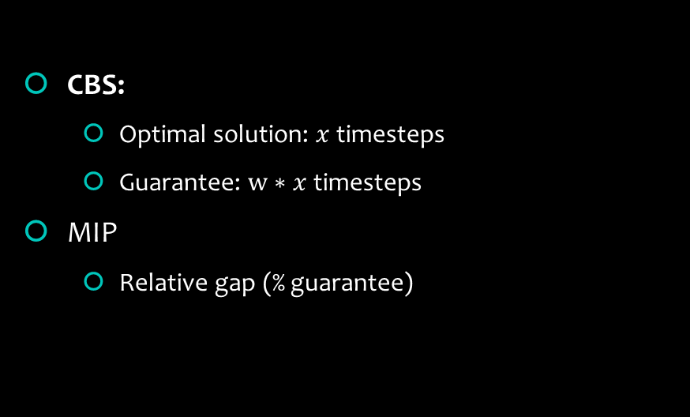
Why optimality?
Bounded suboptimal solution
CBS:
Optimal solution: $x$ timesteps
Guarantee: $w∗x$timesteps
MIP
Relative gap (% guarantee)
Notes:
Better starting point!

Slide 20
Conflict Based Search
PUT COSTS!
Conflict Based Search (CBS)
Path collision <a1, a2, location, time>
Constraint <agent, location, time> not!
Search tree
Exponential tree, branching!
Perform Search
Find Conflicts
Resolve Conflicts
Cons:
Cons: {A1, (2,2), 1}
Cons: {A2, (2,2), 1}
Cons: {A1, (2,2), 1} Cons: {A1, (3,2), 2}
Cons: {A1, (2,2), 1} Cons: {A2, (3,2), 2}

Slide 21
Resolving Conflicts
Perform Search
Find Conflicts
Apply Constraints
Cons:
1
2
3
 |  |  | g2
a2 |  |  | g1
 | a1
1 2 3 4
Notes:
Find a path for each agent
Identify conflicts between paths
Perform search again, reduce the number of conflicts

Slide 22
Resolving Conflicts
Perform Search
Find Conflicts
Apply Constraints
Cons:
1
2
3
 |  |  | g2
a2 |  |  | g1
 | a1
1 2 3 4
Notes:
Find a path for each agent
Identify conflicts between paths
Perform search again, reduce the number of conflicts

Slide 23
Resolving Conflicts
Perform Search
Find Conflicts
Apply Constraints
Cons:
1
2
3
 |  |  | g2
a2 |  |  | g1
 | a1
1 2 3 4
Notes:
Find a path for each agent
Identify conflicts between paths
Perform search again, reduce the number of conflicts

Slide 24
Resolving Conflicts
Perform Search
Find Conflicts
Apply Constraints
Cons:
Cons: {A1, (2,2), 1} : 5
Cons: {A2, (2,2), 1}
1
2
3
 |  |  | g2
a2 |  |  | g1
 | a1
1 2 3 4
Notes:
Find a path for each agent
Identify conflicts between paths
Perform search again, reduce the number of conflicts

Slide 25
Resolving Conflicts
Perform Search
Find Conflicts
Apply Constraints
Cons:
Cons: {A1, (2,2), 1}
Cons: {A2, (2,2), 1}
1
2
3
 |  |  | g2
a2 |  |  | g1
 | a1
1 2 3 4
Notes:
Find a path for each agent
Identify conflicts between paths
Perform search again, reduce the number of conflicts

Slide 26
Resolving Conflicts
Perform Search
Find Conflicts
Apply Constraints
Cons:
Cons: {A1, (2,2), 1}
Cons: {A2, (2,2), 1}
1
2
3
 |  |  | g2
a2 |  |  | g1
 | a1
1 2 3 4
Notes:
Find a path for each agent
Identify conflicts between paths
Perform search again, reduce the number of conflicts

Slide 27
Resolving Conflicts
Perform Search
Find Conflicts
Apply Constraints
Cons:
Cons: {A1, (2,2), 1}
Cons: {A2, (2,2), 1}
Cons: {A1, (2,2), 1} Cons: {A1, (3,2), 2}
Cons: {A1, (2,2), 1} Cons: {A2, (3,2), 2}
1
2
3
 |  |  | g2
a2 |  |  | g1
 | a1
1 2 3 4
Notes:
Find a path for each agent
Identify conflicts between paths
Perform search again, reduce the number of conflicts

Slide 28
Resolving Conflicts
Perform Search
Find Conflicts
Apply Constraints
Cons:
Cons: {A1, (2,2), 1}
Cons: {A2, (2,2), 1}
Cons: {A1, (2,2), 1} Cons: {A1, (3,2), 2}
Cons: {A1, (2,2), 1} Cons: {A2, (3,2), 2}
1
2
3
 |  |  | g2
a2 |  |  | g1
 | a1
1 2 3 4
Notes:
Find a path for each agent
Identify conflicts between paths
Perform search again, reduce the number of conflicts

Slide 29
Resolving Conflicts
Perform Search
Find Conflicts
Apply Constraints
Cons:
Cons: {A1, (2,2), 1}
Cons: {A2, (2,1), 1}
Cons: {A1, (2,2), 1} Cons: {A1, (3,2), 2}
Cons: {A1, (2,2), 1} Cons: {A2, (3,2), 2}
1
2
3
 |  |  | g2
a2 |  |  | g1
 | a1
1 2 3 4
Notes:
Find a path for each agent
Identify conflicts between paths
Perform search again, reduce the number of conflicts

Slide 30
CBS and Bypassing
Cons:
Cons: {A1, (2,2), 1}
Cons: {A2, (2,2), 1}
Cons: {A1, (2,2), 1} Cons: {A1, (3,2), 2}
Cons: {A1, (2,2), 1} Cons: {A2, (3,2), 2}
 |  |  | a2
a2 |  |  | a1
 | a1
Compare children in the constraint tree
Choose path with least number of conflicts
Notes:
Find a path for each agent
Identify conflicts between paths
Perform search again, reduce the number of conflicts

Slide 31
Whats wrong with CBS

Slide 32
Our idea
Apply Dantzig-Wolfe reformulation to MAPF
Well known
Column gen

Slide 33
Example 2
 |  |  | g2
a2 |  |  | g1
 | a1

Slide 34
Example 2
 |  |  | g2
a2 |  |  | g1
 | a1
M = 10 // estimated maximum path distance
Minimize 3p1 + 4p2 + Mq1 + Mq2
subject to
p1 + q1 = 1
p2 + q2 = 1
p1 + p2 <= 1
p1, p2, q1, q2 >= 0
LP solution: p1 = 1, q2 = 1

Slide 35
Example 2
 |  |  | g2
a2 |  |  | g1
 | a1
M = 10 // estimated maximum path distance
Minimize 3p1 + 3p1’ + 4p2 + 4p2’ + Mq1 + Mq2
subject to
p1 + q1 = 1
p2 + q2 = 1
p1’ + q1’ = 1
p2’ + q2’ = 1
p1 + p2 + p2’ <= 1
p1,p2,p1’,p2’,q1,q2,q1’,q2’ >= 0
LP solution: p1 = 1, q2 = 1

Slide 36
Example 2
 |  |  | g2
a2 |  |  | g1
 | a1
M = 10 // estimated maximum path distance
Minimize for (0…i) p_i + q_i
subject to
p1 + q1 = 1
p2 + q2 = 1
p1’ + q1’ = 1
p2’ + q2’ = 1
p1 + p2 + p2’ <= 1
p1,p2,p1’,p2’,q1,q2,q1’,q2’ >= 0
LP solution: p1 = 1, q2 = 1

Slide 37
Example 2
M = 10
 |  |  | g2
a2 |  |  | g1
 | a1
Min 3p1 + 4p2 + M q1 + M q2
s.t.
p1 + q1 = 1
p2 + q2 = 1
p1 + p2 <= 1
p1, p2, q1, q2 >= 0
lP ryilguyk p1 = 1, q2 = 1

Slide 38
Example 2
Tree / think about branching
fractional
bnp
M = 10
 |  |  | g2
a2 |  |  | g1
 | a1
Min 3p1 + 3p1` + 4p2 + 4p2` + M q1 + M q2
s.t.
p1 + p1` + q1 = 1
p2 + p2` + q2 = 1
p1 + p2 + p2` <= 1
p1, p1`, p2, p2`, q1, q2 >= 0
lP ryilguyk p1` = 1, p2 = 1

Slide 39
Branch and price
Generate Mixed Integer Program
Run solver
Receive solution
Place a ‘price’ solution
Generate more columns

Slide 40
Penalise conflicts
No branching

Slide 41
Master
Slave

Slide 42
Master problem formulation

Slide 44
Mixed Integer programming
Branch and bound
Highly optimized solvers
minimize 5x + 10y
subject to
0 >= x > 3
0 >= y < 5

Slide 45

Model
Solve
Output
minimize x + y
subject to
0>= x > 2
0>= y < 5
x = 3
y = 0
SCIP solver

Slide 46
Previous work in MIP
Work by Jingjin Yu and Steven M. LaVelle
Multi-agent Path Planning and Network Flow
Planning Optimal Paths for Multiple Robots on Graphs

Slide 47
Current progress
Warehouse Simulation
Picking station
Drive Units
Order assignment
Learning Integer Programming

Slide 48
Simulation

Slide 49
Expected outcomes?
Fleet size reduced by up to 50%

Slide 50
Future Work

Slide 51
Conclusion
Hard problem
Improve state fo the art (CBS)

Slide 52
Thanks!
Questions

